Slide 1
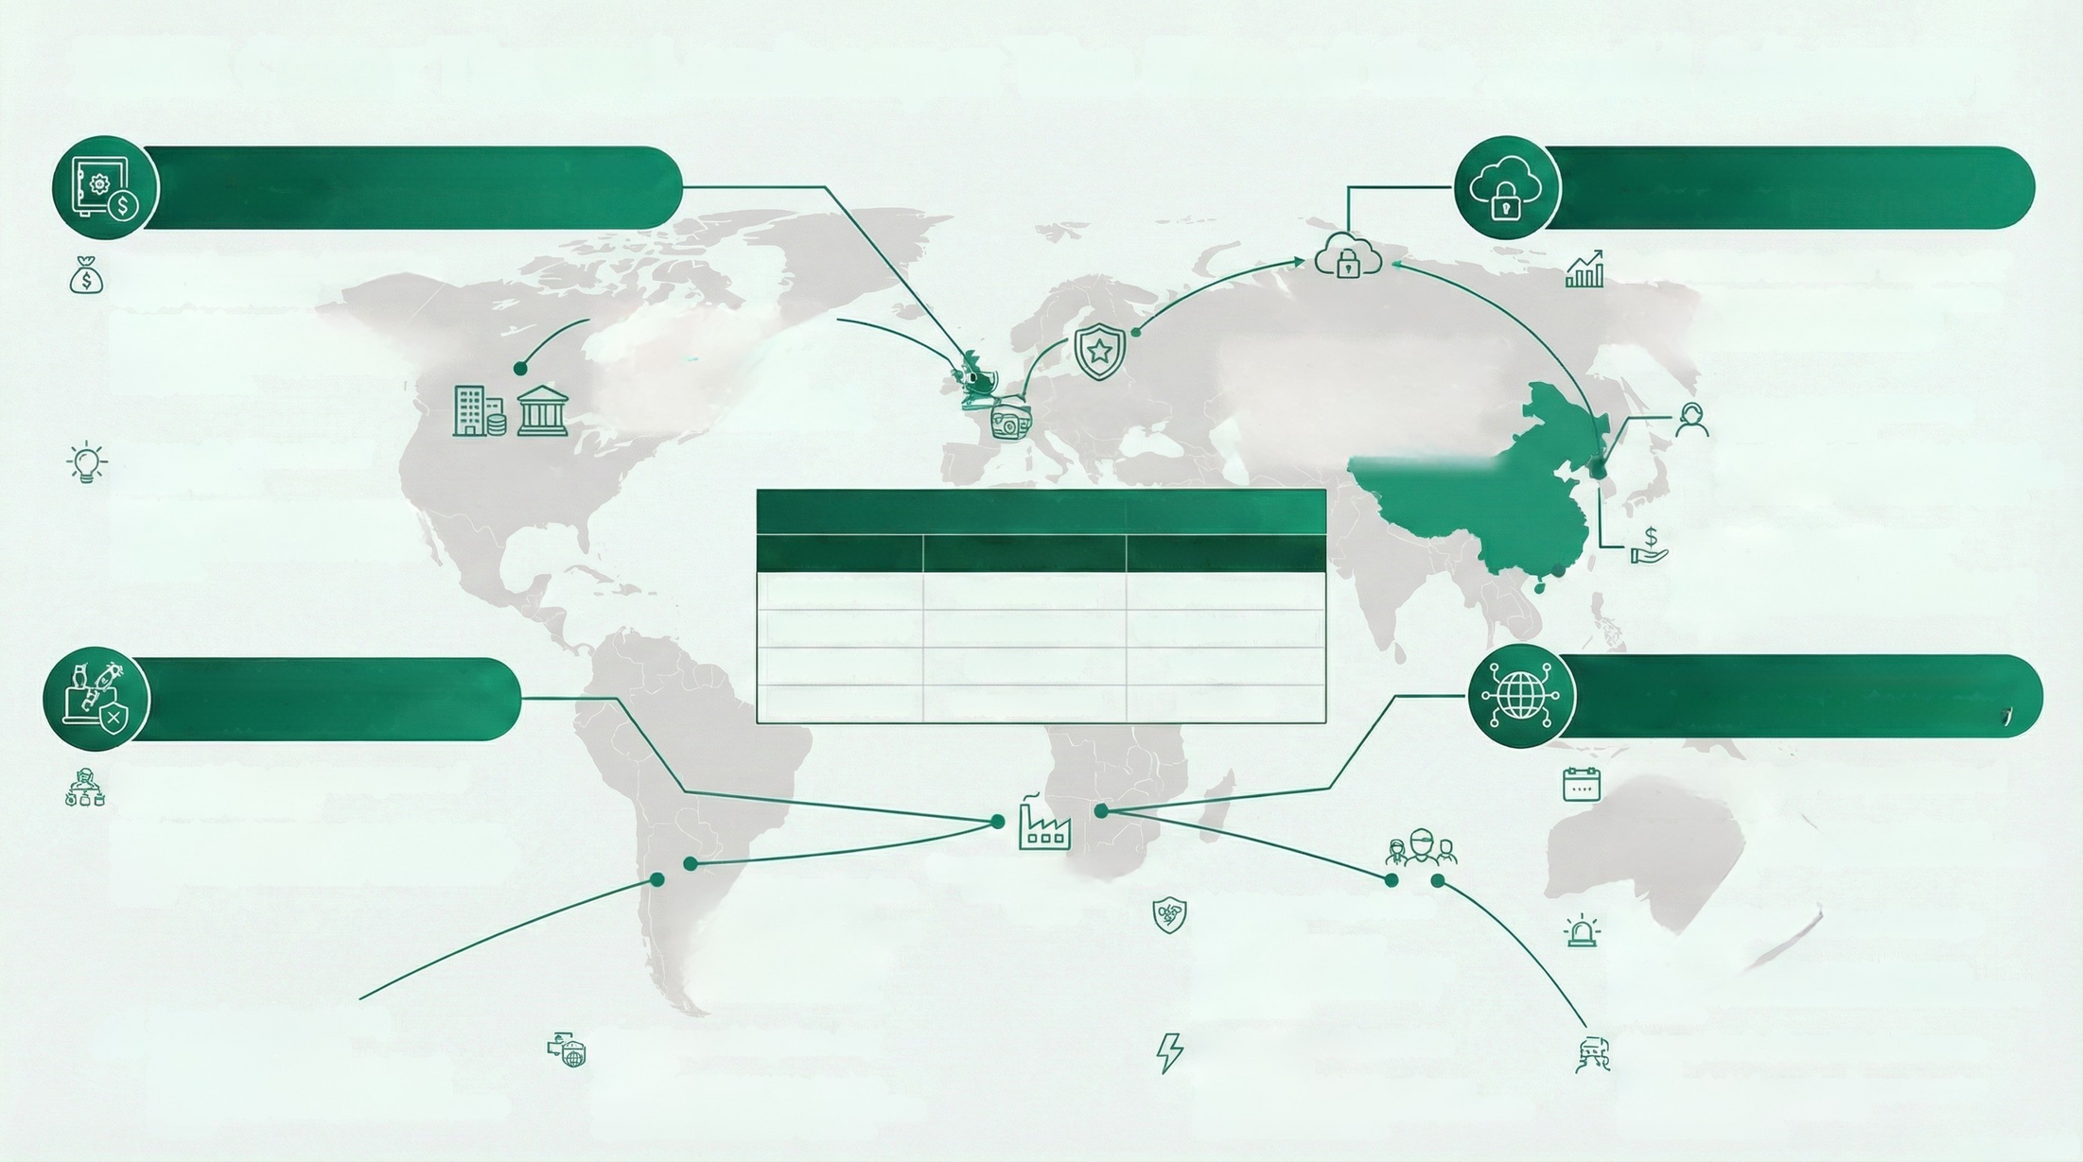

2025 Cyber Threat Landscape: The Rise of the Hybrid Adversary
THE "HYBRID" STATE-FINANCIAL NEXUS
(DPRK Nexus)
CLOUD & IDENTITY SPECIALISTS
(Advanced eCrime)
Lazarus Group: The $3.4 Billion
Crypto-Theft Driver
Responsible for record-breaking thefts,
including the $1.3 billion Bybit heist achieved via a sophisticated supply chain expioit in storage software.
The 16 Billion Credential "Mega Leak"
An early 2025 aggregation of historical breaches rendered password-based authentication obsolete and fueled automated account takeovers
Social Engineering 2.0 via "Operation DreamJob":
Actors utilized Linkedin and WhatsApp for month-long engagements to deliver payloads, moving beyond standard plushing.
Western cloud-based
organizations
UNCSS37 (The Snowflake Actor)
Systematically targeted over 160 organizations, including Santander and Tickermaster, by exploiting cloud environments leaking Multi-Factor Authentication (MFA)
European
defense
Scattered Spider (UNC3944):
Identity Hijacking
Targeted global retail (Marks & Spencer) and alrlines using "MFA Fatigue" and social engineering to impersonate IT support.
Famous Chollima: The IT
Insider Threat
North Koreen actors posed as remote IT developers to infiltrate Western Fintechs and European defense sectore to inject backdoors.
Western
fintech
2025 TOP EXPLOITED VULNERABILITIES
Vulnerability
Target System
Primary Threat Actor
SaaS-to-SaaS Lateral Movement
ShinyHunters compromised OAuth
integration tokens (e.g., Salesforce/Salesloft) to access data without needing direct user credentials.
CVE-2025-61882
CVE-2025-53770
CVE-2025-64446
CVE-2025-10035
Oracle EBS (ERP)
Microsoft SharePoint
FortiWeb WAF
GoAnywhere MFT
Cl0pRansomware
Salt Typhoon / APT27
Volt Typhoon
LockBit 5.0
RANSOMWARE CARTELS &
SPLINTER GROUPS
STATE-SPONSORED ESPIONAGE &
DISRUPTION (China & Russia Nexus)
Fragmentation and Resurgence of
"Big Game Hunting"
Salt Typhoon: Rapid Weaponization of
Vulnerabilities
Exploited "ToolShell" vulnerabilities in Microsoft
SharePoint to compromise government and healthcare networks globally.
Following law enforcement actions against major cartels, aggressive splinter groups like RansomHub and Qilin emerged with ruthless "double extortion"
tactics.
European manufacturing
and core banking
targets
Inter-Bank
Messaging Exploitation
Targeted a monolithic third-party software provider to compromise over 100 financial institutions, specifically causing secondary infections across UK and European banking partner networks
LockBit 5.0: Targeting Core Banking Infrastructure
The resurfaced group deployed cross-platform capabilities specifically targeting Linux and VMware ESXi servers.
NoName057(16): DDoS as Strategic
Harassment
Russia-aligned hacktivists targeted European
transport and public administration to disrupt support for Ukraine.
Jaguar Land Rover (JLR)
Catastrophic Outage
Cl0p: Weaponizing Zero-Day
Exploits
Utilized CVE-2025-61882 in Oracle E-
Business Suite to perform mass extortion
against multinational ERP systems.
Volt Typhoon: Edge Device
Exploitation
Targeted FortiWeb WAF appliances (CVE-2025-64448) to maintain persistencein critical infrastructure.
Mustang Panda (HoneyMyte): European Focus
A ransomware attack forced a 5-week
standown of UK plants, resulting in an
estimated £1.9 billion (22.3 billion) economic
impact.
Maintained a high operational tempo targeting ministries of foreign affairs and telecommunications.

